Slide 1
Chapter 1: An Overview of Computers and Programming Languages

Slide 2
Objectives
In this chapter, you will:
Learn about different types of computers
Explore hardware and software
Learn about the language of a computer
Learn about the evolution of programming languages
Examine high-level programming languages

Slide 3
Objectives (cont’d.)
Discover what a compiler is and what it does
Examine a C++ program
Explore how a C++ program is processed
Learn what an algorithm is and explore problem-solving techniques
Become aware of structured design and object-oriented design programming methodologies
Become aware of Standard C++ and ANSI/ISO Standard C++

Slide 4
Introduction
Without software, the computer is useless
Software is developed with programming languages
C++ is a programming language
C++ suited for a wide variety of programming tasks

Slide 5
Elements of a Computer System
Hardware
CPU
Main memory
Secondary storage
Input/Output devices
Software

Slide 6
Hardware
CPU
Main memory: RAM
Input/output devices
Secondary storage

Slide 7
Central Processing Unit and Main Memory
Central processing unit
Brain of the computer
Most expensive piece of hardware
Carries out arithmetic and logical operations

Slide 8
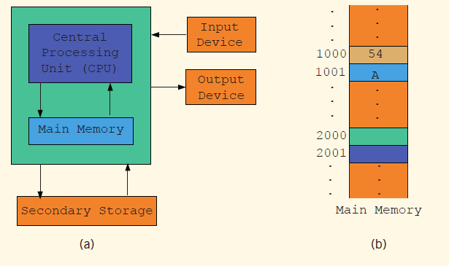
Central Processing Unit and Main Memory (cont’d.)

Slide 9
Central Processing Unit and Main Memory (cont'd.)
Random access memory
Directly connected to the CPU
All programs must be loaded into main memory before they can be executed
All data must be brought into main memory before it can be manipulated
When computer power is turned off, everything in main memory is lost

Slide 10
Central Processing Unit and Main Memory (cont’d.)
Main memory is an ordered sequence of memory cells
Each cell has a unique location in main memory, called the address of the cell
Each cell can contain either a programming instruction or data

Slide 11
Secondary Storage
Secondary storage: device that stores information permanently
Examples of secondary storage:
Hard disks
Flash drives
Floppy disks
Zip disks
CD-ROMs
Tapes

Slide 12
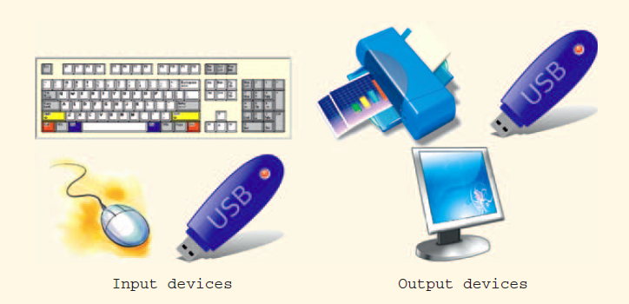

Input/Output Devices
Input devices feed data and programs into computers
Keyboard
Mouse
Secondary storage
Output devices
display results
Monitor
Printer
Secondary storage

Slide 13
Software
Software: programs that do specific tasks
System programs control the computer
Operating system monitors the overall activity of the computer and provides services such as:
Memory management
Input/output activities
Storage management
Application programs perform a specific task
Word processors
Spreadsheets
Games

Slide 14
The Language of a Computer
Machine language: language of a computer; a sequence of 0s and 1s
Binary digit (bit): the digit 0 or 1
Binary code (binary number): a sequence of 0s
and 1s

Slide 15
The Evolution of Programming Languages
Early computers were programmed in machine language
To calculate wages = rate * hours in machine language:
100100 010001 //Load
100110 010010 //Multiply
100010 010011 //Store

Slide 16
The Evolution of Programming Languages (cont’d.)
Low Level language : closely to processor instructions
Assembly language
Example : Using assembly language instructions, wages = rate • hours can be written as:
LOAD rate
MULT hour
STOR wages
Assembler: translates a program written in assembly language into machine language

Slide 17
The Evolution of Programming Languages (cont’d.)
High-level languages include Basic, FORTRAN, COBOL, Pascal, C, C++, C#, and Java
Compiler: translates a program written in a high-level language into machine language
The equation wages = rate • hours can be written in C++ as:
wages = rate * hours;

Slide 18
Processing a C++ Program
#include <iostream>
using namespace std;
int main()
{
cout << "My first C++ program." << endl;
return 0;
}
Sample Run (after execute):
My first C++ program.

Slide 19
Processing a C++ Program (cont’d.)
To execute a C++ program:
Use an editor to create a source program in C++ (saved in extension of .cpp).
Source program: A program written in a high-level language.
Preprocessor directives begin with # and are processed by the preprocessor.
Use the compiler to:
Check that the program obeys the language rules
Translate into machine language (object program)

Slide 20
Processing a C++ Program (cont’d.)
To execute a C++ program (cont'd.):
Linker:
Combines object program with other programs provided by the SDK to create executable code.
Library: contains prewritten code you can use
Loader:
Loads executable program into main memory
The last step is to execute the program
Some IDEs (integrated development environment) do all this with a Build or Rebuild command

Slide 21
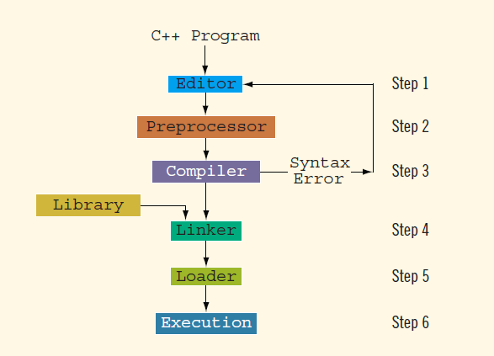
Processing a C++ Program (cont’d.)
.cpp / .c / .h
.s
Assembler
.o
.exe
Source program
High level
language
Low level
language
Object program
0/1 sequence
Machine language

Slide 22
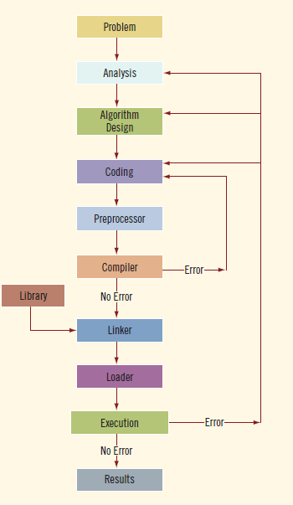
Programming with the Problem Analysis–Coding–Execution Cycle
Algorithm:
Step-by-step problem-solving process
Solution achieved in finite amount of time
Programming is a process of problem solving
Why checking the error existence twice ?

Slide 23
The Problem Analysis–Coding–Execution Cycle (cont’d.)
Step 1: Analyze the problem
Outline the problem and its requirements
Design steps (algorithm) to solve the problem (pseudo code)
Step 2: Implement the algorithm
Implement the algorithm in code
Verify that the algorithm works
Step 3: Maintenance
Use and modify the program if the problem domain changes

Slide 24
The Problem Analysis–Coding–Execution Cycle (cont’d.)
Thoroughly understand the problem and all requirements
Does program require user interaction?
Does program manipulate data?
What is the output?
If the problem is complex, divide it into subproblems
Analyze and design algorithms for each subproblem
Check the correctness of algorithm
Can test using sample data
Some mathematical analysis might be required

Slide 25
The Problem Analysis–Coding–Execution Cycle (cont’d.)
Once the algorithm is designed and correctness verified
Write the equivalent code in high-level language
Enter the program using text editor

Slide 26
The Problem Analysis–Coding–Execution Cycle (cont’d.)
Run code through compiler
If compiler generates errors
Look at code and remove errors
Run code again through compiler
If there are no syntax errors
Compiler generates equivalent machine code
Linker links machine code with system resources

Slide 27
The Problem Analysis–Coding–Execution Cycle (cont’d.)
Once compiled and linked, loader can place program into main memory for execution
The final step is to execute the program
Compiler guarantees that the program follows the rules of the language (syntax checking)
Does not guarantee that the program will run correctly

Slide 28
Example 1-1
Design an algorithm to find the perimeter and area of a rectangle
The perimeter and area of the rectangle are given by the following formulas:
perimeter = 2 * (length + width)
area = length * width

Slide 29
Example 1-1 (cont’d.)
Algorithm:
Get length of the rectangle
Get width of the rectangle
Find the perimeter using the following equation:
perimeter = 2 * (length + width)
Find the area using the following equation:
area = length * width

Slide 30
Example 1-5
Calculate each student’s grade
10 students in a class; each student has taken five tests; each test is worth 100 points
Design algorithms to:
Calculate the grade for each student and class average
Find the average test score
Determine the grade
Data: students’ names; test scores

Slide 31
Example 1-5 (cont’d.)
Algorithm to determine the average test score:
Get the five test scores
Add the five test scores
Suppose sum stands for the sum of the test scores
Suppose average stands for the average test score:
average = sum / 5;

Slide 32
Example 1-5 (cont’d.)
Algorithm to determine the grade:
if average is greater than or equal to 90
grade = A
otherwise
if average is greater than or equal to 80 and less than 90
grade = B
otherwise
if average is greater than or equal to 70 and less than 80
grade = C
otherwise
if average is greater than or equal to 60 and less than 70
grade = D
otherwise
grade = F

Slide 33
Example 1-5 (cont’d.)
Main algorithm is as follows:
totalAverage = 0;
Repeat the following for each student:
Get student’s name
Use the algorithm to find the average test score
Use the algorithm to find the grade
Update totalAverage by adding current student’s average test score
Determine the class average as follows:
classAverage = totalAverage / 10

Slide 34
Programming Methodologies
Two popular approaches to programming design
Structured
Object-oriented

Slide 35
Structured Programming
Structured design:
Dividing a problem into smaller subproblems
Structured programming:
Implementing a structured design
The structured design approach is also called:
Top-down (or bottom-up) design
Stepwise refinement
Modular programming

Slide 36
Object-Oriented Programming
Object-oriented design (OOD)
Identify components called objects
Determine how objects interact with each other
Specify relevant data and possible operations to be performed on that data
Each object consists of data and operations on that data

Slide 37
Object-Oriented Programming (cont’d.)
An object combines data and operations on the data into a single unit
A programming language that implements OOD is called an object-oriented programming (OOP) language
Must learn how to represent data in computer memory, how to manipulate data, and how to implement operations

Slide 38
Object-Oriented Programming (cont’d.)
Write algorithms and implement them in a programming language
Use functions to implement algorithms
Learn how to combine data and operations on the data into a single unit called an object
C++ was designed to implement OOD
OOD is used with structured design

Slide 39
ANSI/ISO Standard C++
C++ evolved from C
C++ designed by Bjarne Stroustrup at Bell Laboratories in early 1980s
Many different C++ compilers were available
C++ programs were not always portable from one compiler to another
In mid-1998, ANSI/ISO C++ language standards were approved

Slide 40
Summary
Computer: electronic device that can perform arithmetic and logical operations
Computer system has hardware/software
Central processing unit (CPU): brain
Primary storage (MM) is volatile; secondary storage (e.g., disk) is permanent
Operating system monitors overall activity of the computer and provides services
Various kinds of languages

Slide 41
Summary (cont’d.)
Compiler: translates high-level language into machine code
Algorithm: step-by-step problem-solving process; solution in finite amount of time
Problem-solving process has three steps:
Analyze problem and design an algorithm
Implement the algorithm in code
Maintain the program

Slide 42
Summary (cont’d.)
Structured design:
Problem is divided into smaller subproblems
Each subproblem is solved
Combine solutions to all subproblems
Object-oriented design (OOD): a program is a collection of interacting objects
Object: data and operations on those objects

